Slide 1

Vision-Based Driver Drowsiness Monitoring System using OpenCV
DSA0216 – Computer Vision with Open CV for Modern AI
GUIDED BY:
Dr.Senthilvadivu.S
Dr.Kumaragurubaran.T
PRESENTED BY
Ch.Likhitha (192424239)
S.Sri Sai Prasanna Durga (192424241)

Slide 2


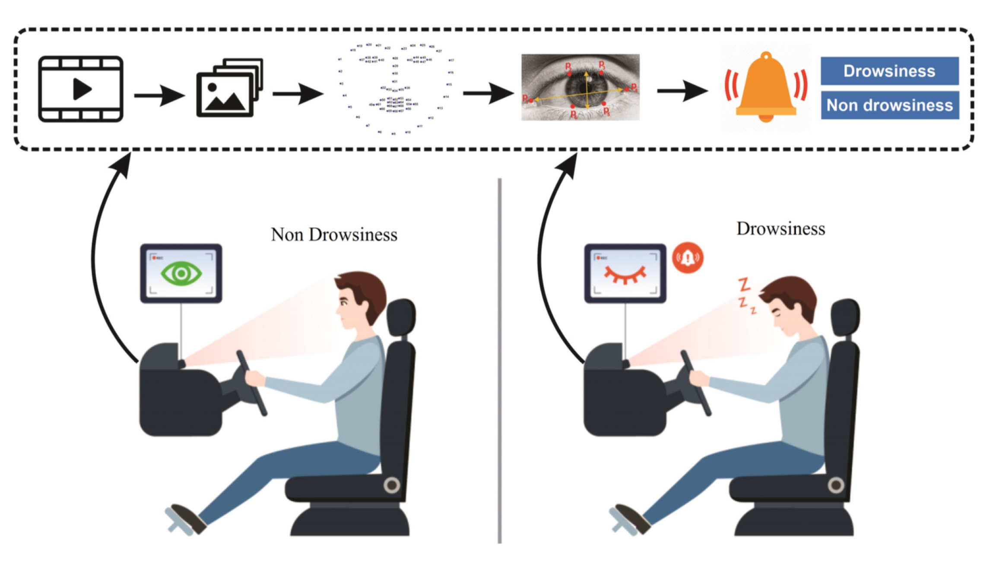
INTRODUCTION
Driver fatigue is a major cause of road accidents and reduces driver alertness.
The project develops a Vision-Based Driver Drowsiness Monitoring System using Python and OpenCV.
The system captures real-time video through a webcam to monitor the driver’s face and eyes.
Haar Cascade algorithms are used for face and eye detection.
The system detects prolonged eye closure and identifies drowsiness.
When drowsiness is detected, the system provides an alert and alarm to warn the driver.

Slide 3
LITERATURE REVIEW
Method Used | Year | Technique Focus | Application Area | Contribution
Deep Learning (CNN) | 2024 | Eye state classification | Driver fatigue detection | Improves accuracy under different lighting conditions
Haar Cascade + OpenCV | 2022 | Face and eye detection | Real-time monitoring | Provides fast and low-cost detection approach
Hybrid ML + Vision | 2023 | Feature-based fatigue analysis | Intelligent transportation safety | Enhances detection reliability
Vision-Based ADAS Model | 2025 | Real-time alert generation | Road safety systems | Confirms effectiveness of automatic warning systems

Slide 4
OBJECTIVES
To develop a real-time driver drowsiness detection system using Python and OpenCV.
To detect the driver’s face and eyes using Haar Cascade classifiers.
To monitor eye closure duration to identify signs of fatigue.
To provide a visual warning message when drowsiness is detected.
To trigger an alarm sound to alert the driver and prevent accidents.
To design a simple, low-cost, and non-intrusive safety system using a webcam.

Slide 5
PROBLEM STATEMENT
Driver drowsiness is a major cause of road accidents due to reduced alertness and slow reaction time.
Existing fatigue detection systems are expensive and require specialized hardware.
Many systems are complex and not easily accessible for students or low-cost implementation.
There is a need for a real-time monitoring system using a standard webcam.
The system should automatically detect face and eye behaviour to identify drowsiness.
An immediate alert mechanism is required to warn the driver and prevent accidents.

Slide 6
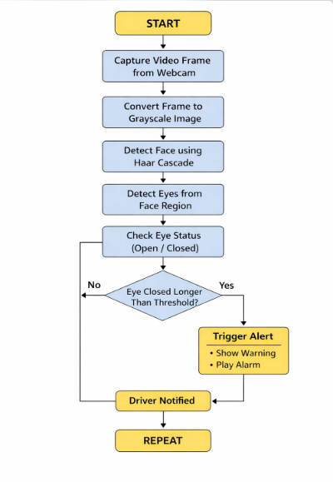
ARCHITECTURE DIAGRAM

Slide 7
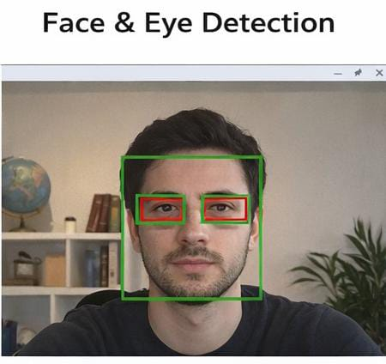
Module 1: Face and Eye Detection
This module is responsible for detecting the driver’s face and eyes in real time using computer vision techniques.
The system captures live video through a webcam and processes each frame using the OpenCV library.
Haar Cascade classifiers are used to identify facial features.
First, the face region is detected from the video frame.
Within the detected face area, the system locates the eyes and marks them with bounding rectangles.

Slide 8
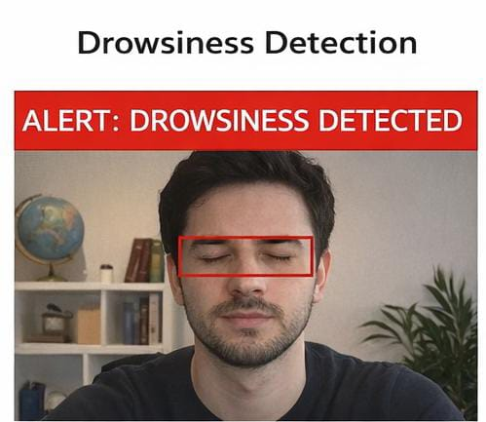
Module 2: Drowsiness Detection and Alert System
It Continuously monitor the driver’s eyes in real-time using a webcam.
It detects eye closure by calculating the Eye Aspect Ratio (EAR) for each frame.
EAR decreases when the eyes are closed; high when eyes are open.
It measures the duration of continuous eye closure; if it exceeds a certain time, classify the driver as drowsy.
Trigger alerts: display warning messages on the screen and generate a beep sound to wake the driver, then resume monitoring.

Slide 9
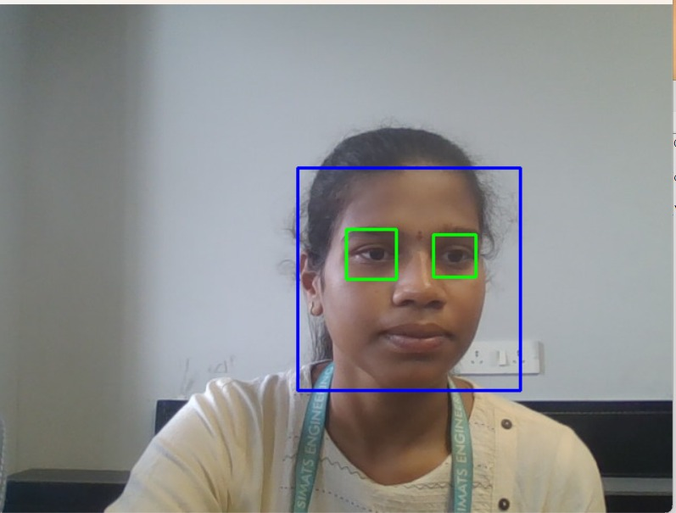

IMPLEMENTATION

Slide 10
RESULTS & DISCUSSION
The system detects the driver’s face and eyes in real time and triggers visual + audio alerts when prolonged eye closure is detected.
The prototype works smoothly on a normal laptop with a webcam, showing practical feasibility for basic driver monitoring.
Detection accuracy is good under proper lighting and frontal face position, but performance decreases in poor lighting or tilted head angles.
The threshold-based fatigue detection method is simple, fast, and suitable for real-time safety applications similar to basic ADAS features.
The project proves how computer vision can enhance road safety, with future improvements possible using deep learning for higher accuracy.

Slide 11
CONCLUSION
The system detects driver drowsiness in real time using OpenCV.
Face and eye detection are performed using Haar Cascade algorithm.
Eye closure duration is used to identify fatigue.
The system provides visual and audio alerts to warn the driver.
The solution is low-cost and works with a standard webcam.
The project demonstrates the application of computer vision for road safety.

Slide 12
FUTURE SCOPE
Improve detection accuracy using deep learning models instead of basic classifiers.
Integrate the system with vehicle ADAS for automatic safety response during driver fatigue.
Deploy the system as a real-time web or mobile application for wider accessibility.
Add multi-factor fatigue detection such as yawning detection, blink rate, and head movement analysis.
Support night-time monitoring using infrared or low-light camera technology.
Store driver alertness data using cloud-based monitoring for behavior analysis.
Implement the system on embedded platforms like Raspberry Pi for real-world vehicle use.
Provide voice-based and customizable alert mechanisms for better driver response.
Enable smart dashboard integration for modern vehicle environments.
Enhance performance using AI models integrated with OpenCV.

Slide 13
REFERENCES
Kumar, Y. D., & Kumar, S. (2023). Detection of Driver Drowsiness using Hybrid Learning Model.
Abbas, M. A. M., & Ramya, R. (2025). Driver Drowsiness Detection System using OpenCV and Keras.
Janarthanan, A., et al. (2025). Intelligent Drowsiness Detection using Haar Cascade and CNN.
Fonseca, T., & Ferreira, S. (2025). Drowsiness Detection in Drivers: A Review of Deep Learning Models.
Owen, V., & Surantha, N. (2025). Computer Vision-Based Drowsiness Detection for Edge Devices.

Slide 14
THANK YOU

